Slide 1
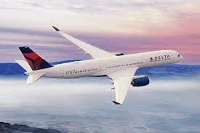

CORRELATION AND REGRESSION ANALYSIS PRESENTATION Delta Airlines Month 4
BY Misheck Malangano

Slide 2
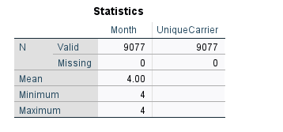
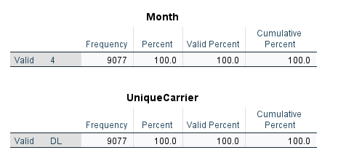
STATISTICS

Slide 3
1st Correlation Table
Correlations
 |  | DepTime | ArrTime | FlightNum | AirTime | ArrDelay | DepDelay | Distance | TaxiIn | TaxiOut | CarrierDelay | WeatherDelay | NASDelay | LateAircraftDelay
DepTime | Pearson Correlation | 1 | .402** | 0.004 | -.038** | .102** | .103** | -.054** | -.024* | .097** | -0.019 | 0.014 | 0.021 | .103**
ArrTime | Pearson Correlation | .402** | 1 | -.045** | 0.009 | -.093** | -.099** | -0.008 | .031** | .046** | -.088** | -.094** | 0.022 | -.071**
FlightNum | Pearson Correlation | 0.004 | -.045** | 1 | -.191** | 0.004 | -0.004 | -.192** | -.119** | -.077** | -.027* | -0.004 | -0.024 | 0.024
AirTime | Pearson Correlation | -.038** | 0.009 | -.191** | 1 | -.039** | -.023* | .980** | .036** | 0.019 | 0.007 | -.026* | 0.001 | -0.012
ArrDelay | Pearson Correlation | .102** | -.093** | 0.004 | -.039** | 1 | .951** | -.072** | .109** | .204** | .580** | .110** | .287** | .565**
DepDelay | Pearson Correlation | .103** | -.099** | -0.004 | -.023* | .951** | 1 | -.023* | .046** | .022* | .605** | .111** | .122** | .579**
Distance | Pearson Correlation | -.054** | -0.008 | -.192** | .980** | -.072** | -.023* | 1 | .054** | -0.007 | 0.011 | -0.024 | -.046** | 0.004
TaxiIn | Pearson Correlation | -.024* | .031** | -.119** | .036** | .109** | .046** | .054** | 1 | -.026* | -.042** | -.033* | .195** | .030*
TaxiOut | Pearson Correlation | .097** | .046** | -.077** | 0.019 | .204** | .022* | -0.007 | -.026* | 1 | -.066** | 0.012 | .382** | -.027*
CarrierDelay | Pearson Correlation | -0.019 | -.088** | -.027* | 0.007 | .580** | .605** | 0.011 | -.042** | -.066** | 1 | -.048** | -.120** | -.165**
WeatherDelay | Pearson Correlation | 0.014 | -.094** | -0.004 | -.026* | .110** | .111** | -0.024 | -.033* | 0.012 | -.048** | 1 | -.026* | 0.006
NASDelay | Pearson Correlation | 0.021 | 0.022 | -0.024 | 0.001 | .287** | .122** | -.046** | .195** | .382** | -.120** | -.026* | 1 | -.091**
LateAircraftDelay | Pearson Correlation | .103** | -.071** | 0.024 | -0.012 | .565** | .579** | 0.004 | .030* | -.027* | -.165** | 0.006 | -.091** | 1
**. Correlation is significant at the 0.01 level (2-tailed).
*. Correlation is significant at the 0.05 level (2-tailed).

Slide 4
MODIFIED CORRELATION TABLE
Correlations
 |  | DepTime | ArrTime | ArrDelay | Distance | TaxiIn | TaxiOut | CarrierDelay | WeatherDelay | NASDelay | LateAircraftDelay
DepTime | Pearson Correlation | 1 | .402** | .102** | -.054** | -.024* | .097** | -0.019 | 0.014 | 0.021 | .103**
ArrTime | Pearson Correlation | .402** | 1 | -.093** | -0.008 | .031** | .046** | -.088** | -.094** | 0.022 | -.071**
ArrDelay | Pearson Correlation | .102** | -.093** | 1 | -.072** | .109** | .204** | .580** | .110** | .287** | .565**
Distance | Pearson Correlation | -.054** | -0.008 | -.072** | 1 | .054** | -0.007 | 0.011 | -0.024 | -.046** | 0.004
TaxiIn | Pearson Correlation | -.024* | .031** | .109** | .054** | 1 | -.026* | -.042** | -.033* | .195** | .030*
TaxiOut | Pearson Correlation | .097** | .046** | .204** | -0.007 | -.026* | 1 | -.066** | 0.012 | .382** | -.027*
CarrierDelay | Pearson Correlation | -0.019 | -.088** | .580** | 0.011 | -.042** | -.066** | 1 | -.048** | -.120** | -.165**
WeatherDelay | Pearson Correlation | 0.014 | -.094** | .110** | -0.024 | -.033* | 0.012 | -.048** | 1 | -.026* | 0.006
NASDelay | Pearson Correlation | 0.021 | 0.022 | .287** | -.046** | .195** | .382** | -.120** | -.026* | 1 | -.091**
LateAircraftDelay | Pearson Correlation | .103** | -.071** | .565** | 0.004 | .030* | -.027* | -.165** | 0.006 | -.091** | 1
**. Correlation is significant at the 0.01 level (2-tailed).
*. Correlation is significant at the 0.05 level (2-tailed).

Slide 5
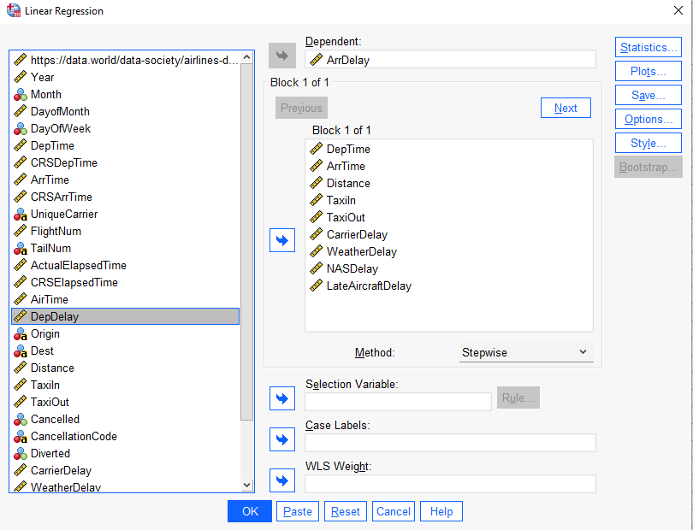
CHOICES MADE FOR REGRESSION ANALYSIS

Slide 6
REGRESSION ANALYSIS Dependent Variable: Arrival Delay
Model Summary
Model | R | R Square | Adjusted R Square | Std. Error of the Estimate
3 | .988^{c} | .977 | .977 | 9.020
c. Predictors: (Constant), Carrier Delay, Late Aircraft Delay, NAS Delay
In this regression, we successfully explained 97.7% of the variance in the dependent variable, Arrival Delay.

Slide 7
ANOVA TABLE
ANOVAª
Model |  | Sum of Squares | df | Mean Square | F | Sig.
3 | Regression | 19987027.269 | 3 | 6662342.423 | 81893.011 | <.001^{d}
 | Residual | 478281.485 | 5879 | 81.354
 | Total | 20465308.754 | 5882
a. Dependent Variable: Arr Delay
d. Predictors: (Constant), Carrier Delay, Late Aircraft Delay, NAS Delay
Based on the ANOVA, the regression demonstrates a linear relationship between the variables, significant at the 0.001 level.

Slide 8
COEFFICIENTS TABLE Dependent Variable: Arrival Delay
Coefficientsª
Model |  | Unstandardized Coefficients |  | Standardized Coefficients | t | Sig.
 |  | B | Std. Error | Beta
3 | (Constant) | 1.558 | .173 |  | 9.028 | <.001
 | Carrier Delay | .989 | .003 | .754 | 369.373 | <.001
 | Late Aircraft Delay | .999 | .003 | .729 | 358.456 | <.001
 | NAS Delay | .989 | .005 | .444 | 219.626 | <.001
a. Dependent Variable: Arrival Delay
The Final Regression equation is:
Arrival Delay= .754*Carrier Delay + 0.729* Late Aircraft Delay + 0.444* Nas Delay

Slide 9
MANAGERIAL IMPLICATIONS
Integrating new technology in the Reservation System. This will help in fast-tracking the booking process and the boarding process, hence reducing the Carrier Delay.
Investing in self-service product promotions to customers will increase self-check-in and fast-track the boarding process.
Increase the capacity of the airline company. Hiring more staff to handle the travel processes.

Slide 10
THANK YOU

